Slide 1
Banking Data Analysis Using PowerBi

Slide 2
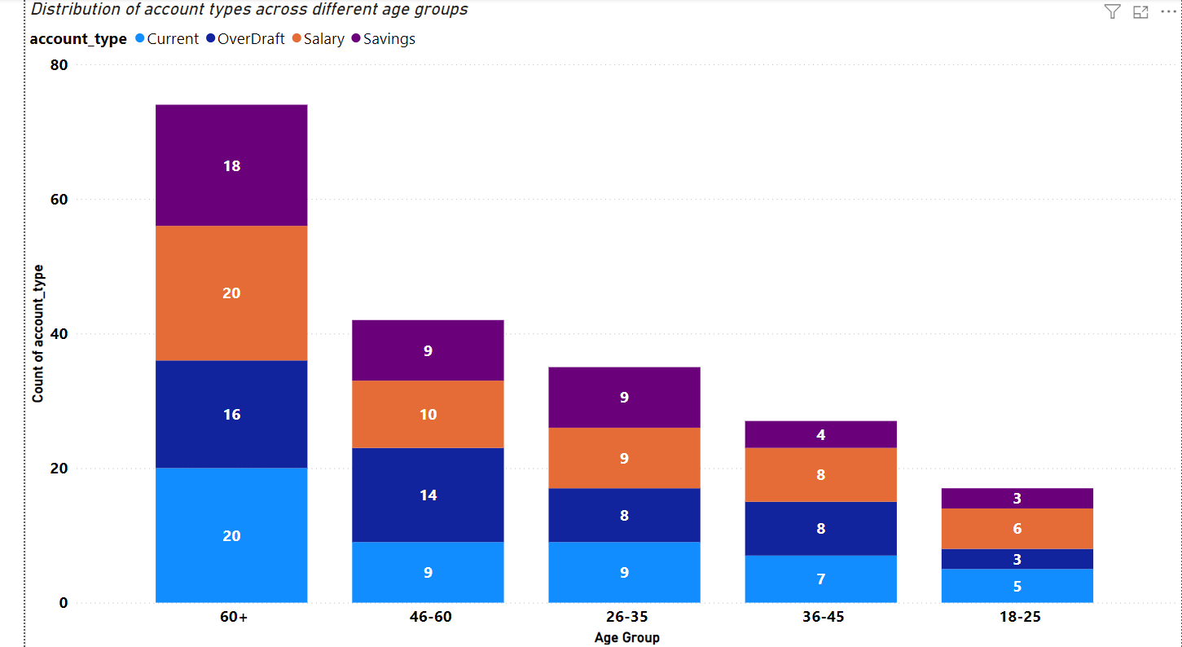
1)Hypothesis: Customers of different age groups prefer different types of accounts (e.g., Savings, Current, Salary, OverDraft)
Analysis:
60+ Age Group
Key Insights:
Savings accounts =18
OverDraft accounts=16
Current accounts=20
Salary accounts=20
46-60 Age Group
Key Insights:
Current accounts=9
OverDraft accounts =14
Savings accounts=9
Salary accounts=10
36-45 Age Group
Key Insights:
Current and OverDraft accounts=7 and 8
Savings accounts=4
Salary accounts=8
26-35 Age Group
Key Insights:
Savings and Current accounts.=9
OverDraft accounts=8
Salary accounts=9
18-25 Age Group
Key Insights:
Savings accounts.=3
Current accounts.=5
OverDraft accounts.=3
Salary accounts.=6
So From Above Analysis Of Count The Hypothesis Is right That Customers of different age groups prefer different types of accounts (e.g., Savings, Current, Salary, OverDraft)

Slide 3
Recommendation
Target Marketing:
Promote Savings accounts to 60+ and 26-35 age groups.
Emphasize Current accounts for 46-60 and 36-45 age groups.
Product Development:
Tailor OverDraft account features for 46-60 and 36-45 age groups.
Develop Salary account incentives for 18-25 age group.
Customer Engagement:
Financial planning workshops for 60+ age group.
Highlight benefits of current accounts to 46-60 age group.
Promotions:
Incentives for Salary accounts to younger age groups.
Special rates for Savings accounts for 26-35 age group.
Personalized Services:
Enhanced services for 60+ age group.
Age-specific financial advisory services.

Slide 4
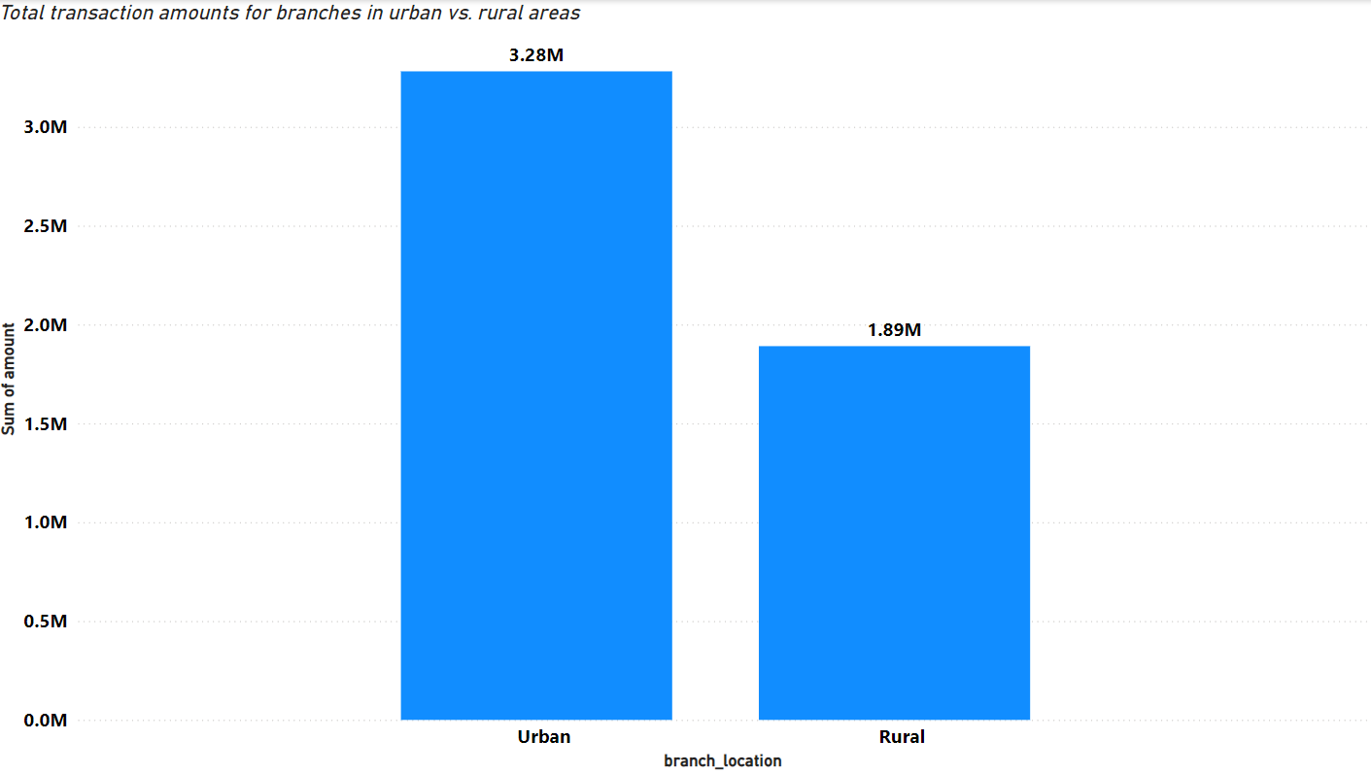
2)Hypothesis: Branches located in urban areas have higher total transaction amounts compared to branches in rural areas.
Analysis:-
According to the Analysis The Urban Branches Total Transaction Amount is 3.28M whereas the Rural Branches Total Transaction Amount is 1.89M So the Hypothesis of Branches located in urban areas have higher total transaction amounts compared to branches in rural areas is Correct.

Slide 5
Recommendations to Increase Rural Transaction Amounts
Improve Accessibility
Implement mobile banking and USSD services.
Deploy agent banking in local shops and underserved areas.
Financial Literacy Programs
Conduct financial literacy workshops.
Train customers on digital banking services and provide support.
Tailored Products and Services
Offer microfinance products and small loans with flexible terms.
Introduce savings and investment plans suited to rural income patterns.
Enhance Customer Experience
Establish dedicated customer support lines with multilingual support.
Improve the infrastructure and service quality of rural branches.
Community Engagement
Partner with local businesses and cooperatives.
Invest in community development projects through CSR initiatives.
Incentive Programs
Introduce referral bonuses and transaction incentives.
Offer promotions that reward frequent transactions.
Marketing and Awareness
Run targeted marketing campaigns via local media and social media.
Share success stories and testimonials to build trust and encourage engagement.

Slide 6
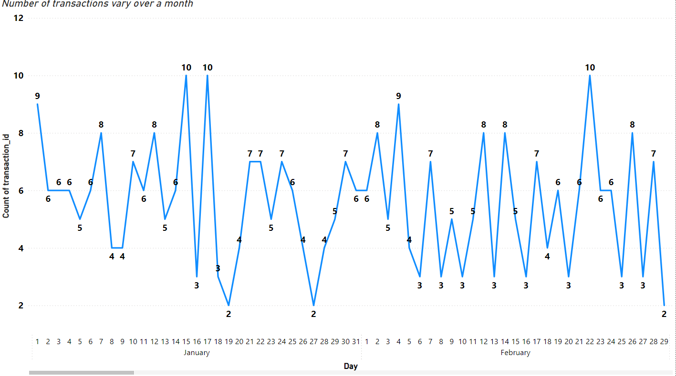
3)Hypothesis: There is a significant increase in the number of transactions at the beginning and end of the month
Month | Transaction Count Of Starting Day Of Month | Transaction Count Of Ending Day Of the Month
January | 9 | 6
February | 6 | 2
March | 4 | 6
April | 6 | 5
May | 6 | 5
June | 8 | 6
July | 4 | 8
August | 5 | 6
September | 3 | 7
October | 9 | 4
November | 7 | 5
December | 3 | 1
Analysis :- The Month March,July,August,September Are The Only Months That Increased Over Month While Other Months Decreased so According to data the hypothesis is wrong

Slide 7
Recommendations
End-of-Month Incentives: Offer special interest rates or bonuses for transactions made towards the end of the month.
Targeted Campaigns: Run end-of-month marketing campaigns via email, SMS, and social media to remind customers of the benefits of making transactions.
Feedback Collection: Understand customer needs and address issues that may be causing the decline.
Personalized Offers: Use customer data to provide personalized offers or reminders.
Ensure Service Availability: Guarantee that all banking services are readily available and promoted towards the end of the month.
Ease of Access: Simplify transaction processes, and enhance digital banking platforms to encourage end-of-month usage.
Cashback and Rewards: Offer cashback or reward points for transactions made at the end of the month.
Implementing these strategies can help maintain a steady transaction count throughout the month.

Slide 8
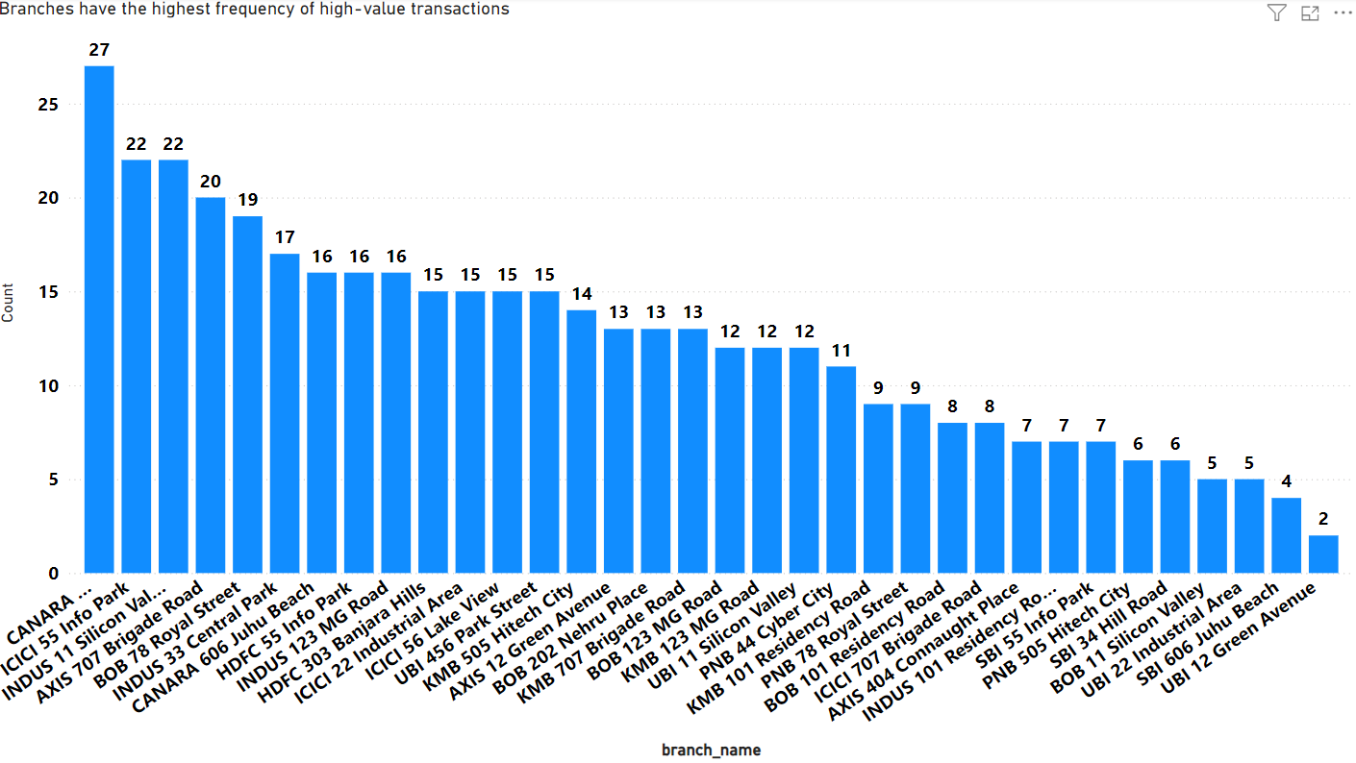
4) Hypothesis: High-value transactions (amounts above a certain threshold) are more frequent in certain branches
Analysis:-
The bar chart shows the frequency of high-value transactions (above 4000) across various branches. Key observations are:
Top Performers:
CANARA :- Highest with 27 transactions.
ICICI 55 Silicon Valley and INDUS 11 Brigade Road: Next highest with 22 transactions each
Mid-Range Performers:
AXIS 707 B Royal Street Road: 20 transactions.
Several branches like HDFC 55 Info Park, HDFC 123 MG Road Hills, etc., show frequencies between 16 and 19 transactions.
Lower Performers:
Branches like UBI 12 Green Avenue: Only 2 transactions.
Several branches show frequencies below 10 transactions.
So According to Above Analysis the hypothesis is correct as the high value customers are more frequent in certain Branches

Slide 9
Recommendations to Increase High-Value Transactions:
Targeted Marketing:-
Focus on branches with mid-range performance to push them towards higher frequencies.
Personalized offers and promotions for high-value customers at lower-performing branches.
Enhanced Customer Service:-
Improve customer service and engagement in branches with fewer high-value transactions to build trust and encourage larger transactions
Product and Service Improvement:-
Introduce or enhance premium banking products and services targeted at high-value customers.
Promote these services more aggressively in branches with lower transaction frequencies.
Local Events and Campaigns:-
Host events or financial planning sessions in branches with low transaction counts to attract high-value customers.
Incentivize Employees:-
Implement incentives for branch employees to encourage high-value transactions through personalized customer engagement.
By focusing on these strategies, branches can potentially increase their high-value transaction counts, aligning with the observed successful practices of top-performing branches.

Slide 10
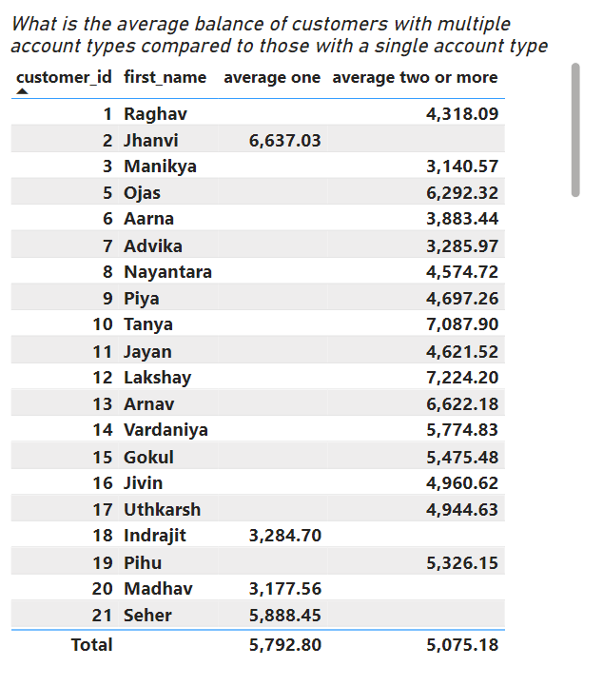
5)Hypothesis: Customers with multiple account types have higher overall balances.
Analysis:-
Single Account Holders:-
Average balance: $5,792
Multiple Account Holders:-
Average balance: $5,075
Possible Reasons
Focus on Single Account:
Single account holders might concentrate their funds in one account, leading to a higher balance.
Distribution of Funds:
Multiple account holders may spread their funds across various accounts, resulting in lower average balances per account.
Usage Patterns:
Single account holders might use their account primarily for savings, while multiple account holders might use their accounts for different purposes, such as savings, expenses, and investments.
Based on the provided data, it appears that single account holders have a higher average balance ($5,792) compared to multiple account holders ($5,075). This contradicts the hypothesis that customers with multiple account types have higher overall balances.

Slide 11
Recommendations
Encourage Consolidation:
Offer incentives for consolidating accounts, such as better interest rates or lower fees for higher balances.
Financial Products:
Develop tailored financial products that cater to multiple account holders, emphasizing benefits like integrated account management.
Financial Planning Services:
Provide personalized financial planning services to help customers manage their funds more effectively across multiple accounts.
Educational Campaigns:
Educate customers on the benefits of maintaining higher balances in fewer accounts for better interest rates and financial management.
Account Linking:
Introduce features that allow customers to link and manage multiple accounts more efficiently, encouraging better fund allocation.

Slide 12
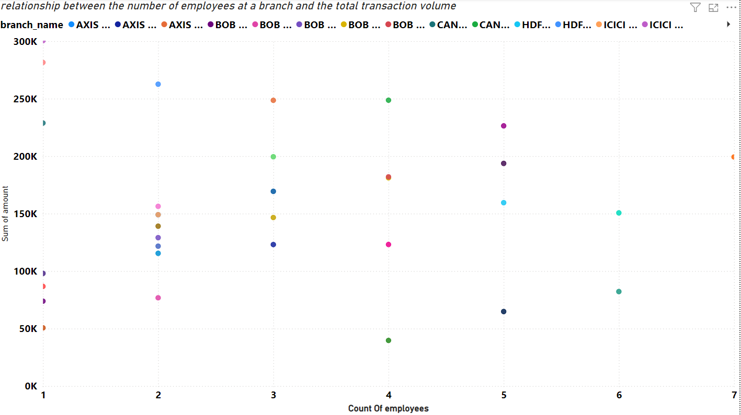
6)Hypothesis: Branches with a higher number of employees handle a larger volume of transactions.
Analysis:-
Plot Description:
The scatter plot displays the Sum of amount on the Y-axis and the Count of employees on the X-axis.
Different colors represent different branches (branch_name).
Vertical Lines:
Vertical lines in a scatter plot suggest that for a given number of employees, the transaction volumes vary widely. This means there is no clear relationship between the number of employees and the transaction volume. The transaction volume is not consistently increasing or decreasing with the number of employees.So The Hypothesis Is Wrong

Slide 13
Recommendations for the Bank
Optimize Employee Productivity
Focus on training and development to ensure employees are performing at their best.
Implement performance-based incentives to encourage higher productivity and better customer service.
Invest in Technology
Utilize advanced banking software and automation tools to enhance transaction processing efficiency.
Implement digital banking solutions to reduce the dependency on the number of employees for transaction volume.
Customer Relationship Management
Enhance customer relationship management (CRM) practices to better understand and meet customer needs.
Use data analytics to identify high-value customers and tailor services to their requirements.
Branch Efficiency
Conduct regular branch audits to identify and eliminate inefficiencies.
Optimize branch operations and layout to improve customer flow and service delivery.
Marketing and Outreach
Strengthen marketing efforts to attract new customers and increase transaction volumes.
Engage in community outreach programs to build trust and expand the customer base.
Feedback Mechanism
Establish a robust feedback mechanism to gather customer insights and improve service offerings.
Regularly review and act on customer feedback to enhance satisfaction and loyalty.
These recommendations aim to enhance overall branch performance and transaction volumes, independent of the number of employees.

Slide 14
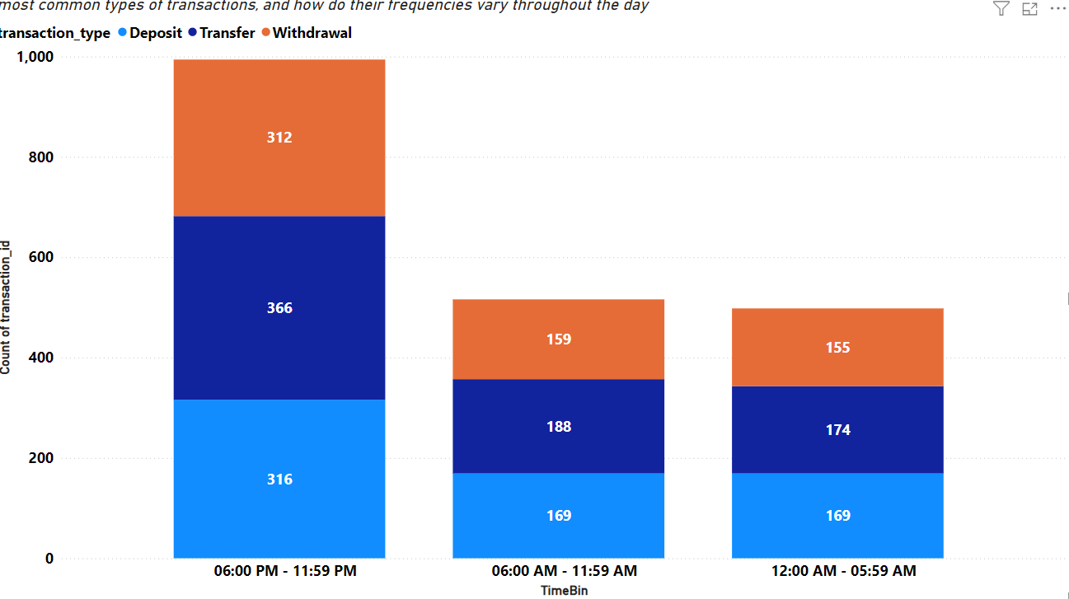
7)Hypothesis: Certain types of transactions (e.g., deposits, withdrawals, transfers) are more common at specific times of the day.
Analysis
06:00 PM - 11:59 PM:
Deposits: 316
Transfers: 366
Withdrawals: 312
Total: 994
06:00 AM - 11:59 AM:
Deposits: 169
Transfers: 188
Withdrawals: 159
Total: 516
12:00 AM - 05:59 AM:
Deposits: 169
Transfers: 174
Withdrawals: 155
Total: 498
Validation: The hypothesis is correct
Evening (06:00 PM - 11:59 PM): Highest transaction volume for all types, with a slight predominance of transfers.
Morning (06:00 AM - 11:59 AM) and Early Morning (12:00 AM - 05:59 AM): Lower transaction volumes, with transfers being slightly more common in the morning and more balanced in the early morning.

Slide 15
Recommendations
Enhance Evening Support
Increase staff or automated support during peak transaction times (06:00 PM - 11:59 PM).
Ensure the availability of customer service and support channels during these hours.
Promote Digital Channels
Encourage customers to use digital banking for transfers and deposits, especially during off-peak hours.
Enhance mobile and online banking features to handle high transaction volumes efficiently.
Optimize Morning Operations
Streamline morning processes to handle the moderate transaction volume efficiently.
Consider early morning promotions or incentives to balance the load throughout the day.
Customer Education
Educate customers on the benefits of performing transactions during off-peak hours to avoid delays and congestion.
Provide clear communication on the best times for different types of transactions.
Resource Allocation
Allocate resources and staff based on transaction volume trends to ensure efficient operations.
Monitor transaction patterns regularly to adjust staffing and support dynamically.

Slide 16
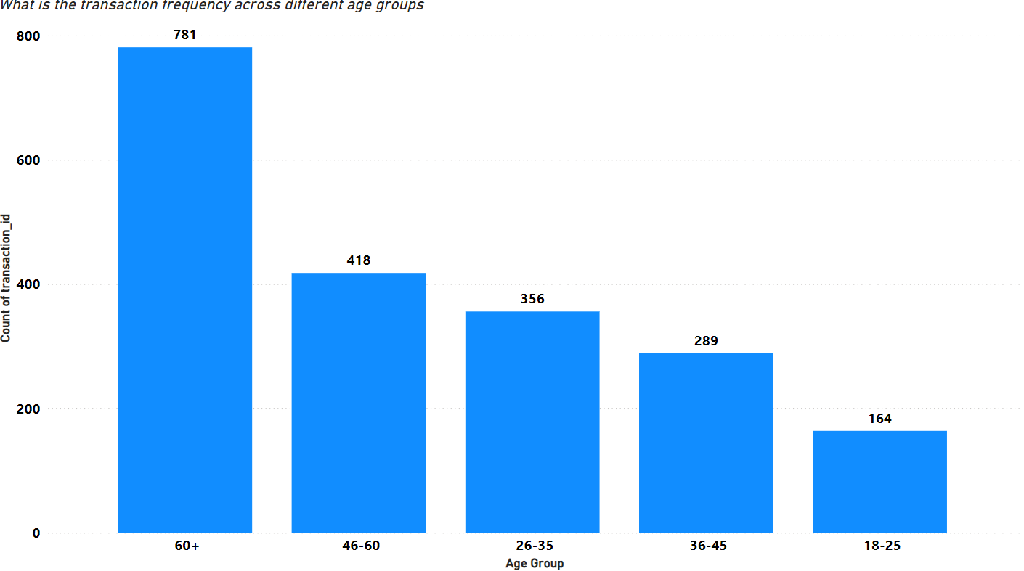
8)Hypothesis: Younger customers (age 18-35) perform more transactions compared to older customers.
Analysis:-
Transaction Frequency Based On Age Group
60+=781
46-60=418
36-45=289
26-35=356
18-25=164
The hypothesis is incorrect.
This data indicates that older customers, particularly those in the 60+ age group, perform the most transactions, contrary to the hypothesis that younger customers (18-35) perform more transactions.

Slide 17
Recommendations
Targeted Marketing for Younger Customers
Increase engagement with customers aged 18-35 through tailored promotions and incentives to boost their transaction frequency.
Implement financial literacy programs to help younger customers understand the benefits of frequent transactions and account management.
Enhance Digital Banking Services
Improve mobile and online banking platforms to make transactions easier and more attractive for all age groups, particularly the tech-savvy younger demographic.
Loyalty Programs for Older Customers
Develop loyalty programs or special offers for customers aged 60+ to maintain and possibly increase their high transaction activity.
Provide personalized financial advice and services to cater to their specific needs and preferences.
Cross-Selling Opportunities
Identify cross-selling opportunities for each age group based on their transaction behavior. For example, promote investment products to the 60+ age group who have higher transaction frequencies.

